Slide 1
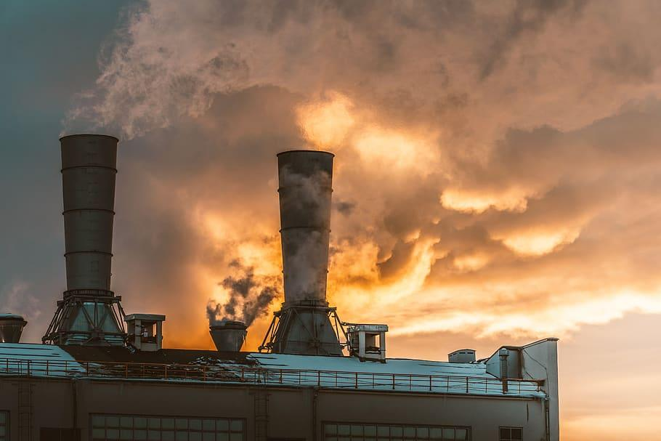
Indian Air Quality
Analysis and Prediction
18BCP095 - Sahil Monpara
18BCP120 - Umang Mehta
18BCP142D - Dhara Barot

Slide 2
Why we choose this Project
Worsening air pollution has been amongst India’s most pressing problems in recent years.
In 2019, air pollution led to about 12.5 percent of all deaths in the country. In the same year, it resulted in an economic loss of approximately 1.4 percent of GDP.
According to IQAir, in 2020, India ranked third amongst all countries in the world with the worst air quality.
Data analysis and prediction can create awareness in the different section of the society.

Slide 3
Literature Review
1. Indian air quality prediction and analysis using machine learning
- Air quality index of India is a standard measure used to indicate the pollutant (so2, no2, rspm, spm. etc.).
- Based on historical data and predicting over a particular upcoming year as aGradient descent boosted multivariable regression problem.
2. Data mining to aid policy making in air pollution management
- Taiwanese government has set up the National Air Quality Monitoring Network (TAQMN) to monitor nationwide air quality.
- Data pre-processing using multi-scale wavelet transforms, data pattern identification using cluster analysis, and final analysis in mapping the identified clusters to geographical locations.
3. Air quality prediction using machine learning algorithm
- Two types of Pollutants that are causing air pollution are Primary Pollutants and Secondary Pollutants.
- Primary Pollutants : Carbon dioxide (CO2),Sulphur oxide (SOX),Nitrogen oxide (NOX), Carbon monoxide (CO),
- Toxic metals : Lead and Mercury
- Secondary Pollutants : Ground Level Ozone , Acid Rain
- Neural Network and boosting model comes out to be superior than other algorithms.

Slide 4
Literature Review
4. Review of Air Quality Monitoring: Case Study of India
- In this paper ten major cities have been taken into consideration for air quality monitoring.
- These cities have been chosen bearing in mind the fact that these cities are major centres for commercial, industrial and tourist.
- Major cause of generation of pollutants : vehicles and automobiles
5. Air Quality Prediction: Big Data and Machine Learning Approaches
- The traditional approaches for air quality prediction use mathematical and statistical techniques.
- In this paper, the major objective is to provide a snapshot of the vast research work and useful review on the current state on applicable big data approaches and machine learning techniques for air quality evaluation and predication.

Slide 5
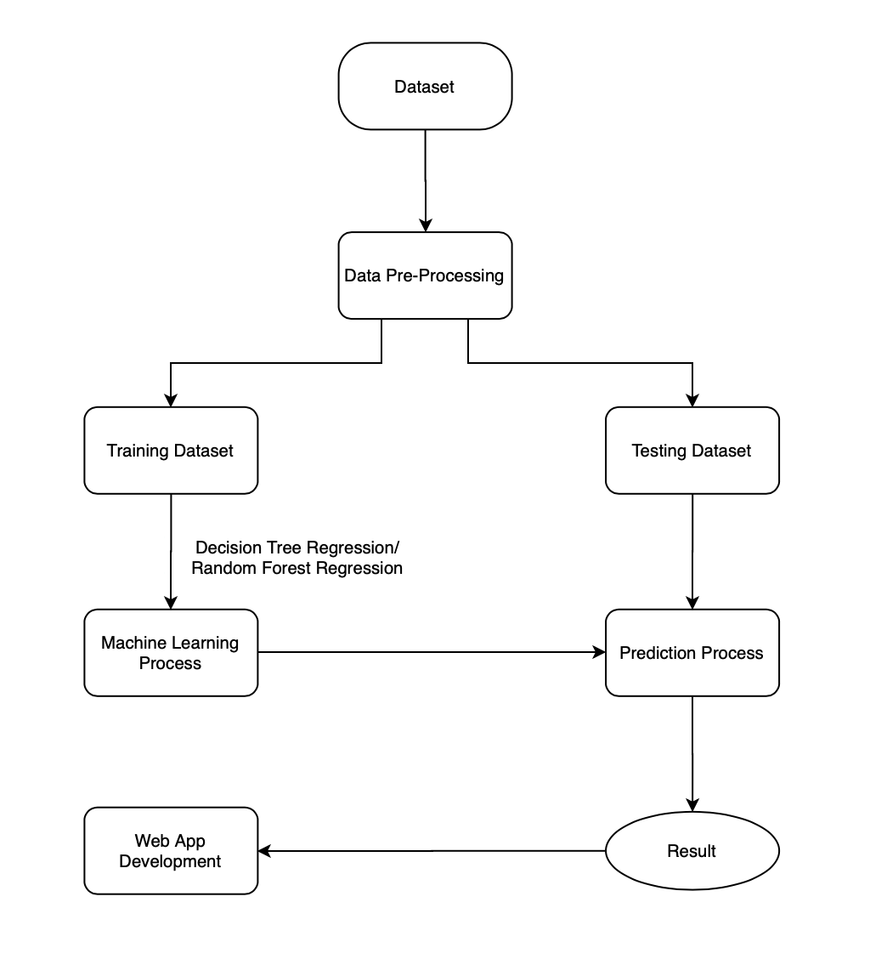
Architecture
Dataset
Data Pre-Processing
Model Training
Result
Web App

Slide 6
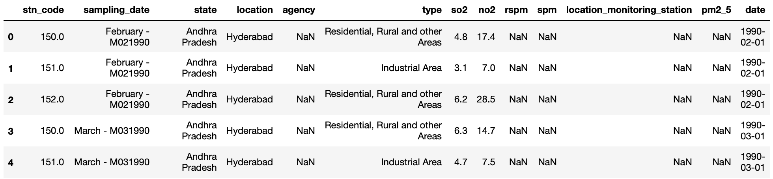
Data-set :
The data is combined (across the years and states) and largely clean version of the Historical Daily Ambient Air Quality Data released by the Ministry of Environment and Forests and Central Pollution Control Board of India under the National Data Sharing and Accessibility Policy (NDSAP) year 1990-2015.
Dataset link : https://www.kaggle.com/shrutibhargava94/india-air-quality-data

Slide 7
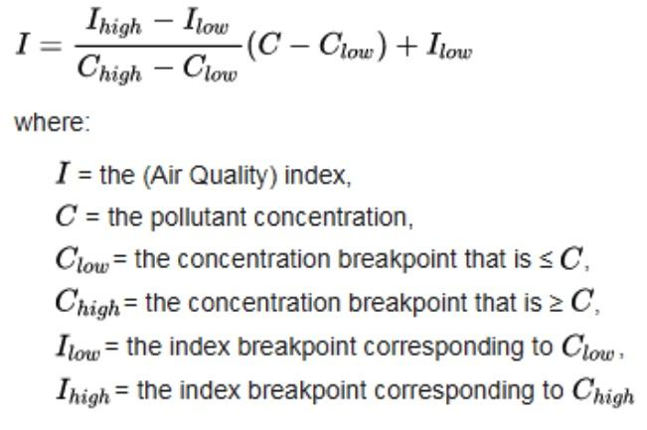
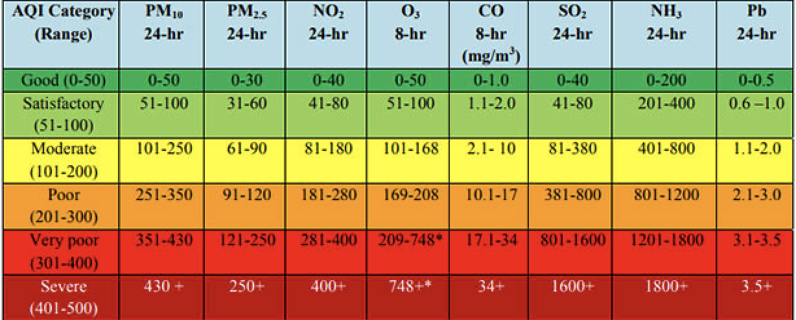
Air Quality Index
An air quality index is a scale used to show how polluted the air is, along with the risks associated with each rating. An AQI is calculated using established standards based on medical research for the acceptable levels of major air pollutants.
Air quality indexes serve two main purposes:
To inform the public about air quality in an comprehensible manner so that they may take action to protect their health
To help countries develop and assess policies for better air quality

Slide 8
Brief about the Pollutants
Sulphur dioxide : 99% of sulfur dioxide in the air comes from human sources. The effects of Sulphur dioxide was felt in very quickly, the worst symptoms after 10 or 15 minute after breathing it.
Nitrogen dioxide : it cause problems such as wheezing, coughing, colds, flu etc. Increased level of nitrogen dioxide can have significant impact on people with asthma because it can cause more frequent and intense attacks.
SPM : Suspended particulate matter (SPM) are finely divided solids or liquids that may be dispersed through the air from combustion processes, industrial activities or natural sources.
RSPM : RSPM refers to particulate matter with diameter of less than or equal to 10 micrometers. They are produced from combustion process, vehicles and industrial sources.

Slide 9
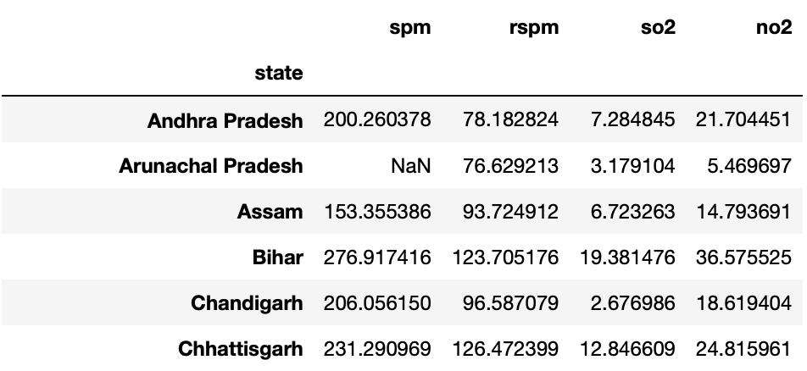
Data Pre-Processing
Dataset Contains 435742 rows and 13 columns.
First, we remove unwanted columns like stn_code, agency, sampling_date, location_monitoring_station, location, type, date, pm2_5.
There are many NANs(Not a Number) values in the dataset.
To get more data, we replace the NaN values with the mean of factors like spm, rspm, so2, no2 which are grouped by states.

Slide 10
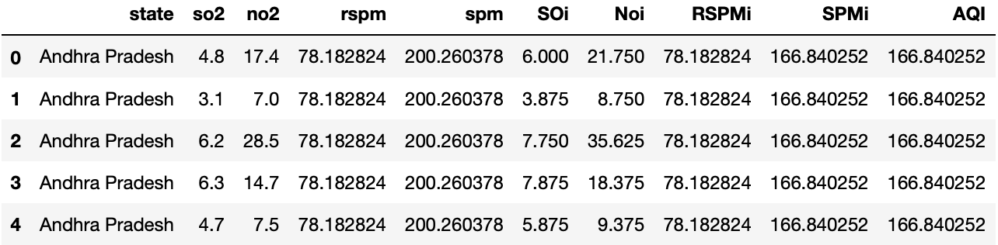
Data Pre-Processing
There are still some NaN values in the dataset.
So, we remove the tuples which contain null values.
Then, we find individual particles’ index of each factor according to the formula.
Add this individual particles’ index in the dataset.
Calculate AQI which is the maximum of these individual particles’ index and add to the dataset.
Now, the data is processed and ready for use.

Slide 11
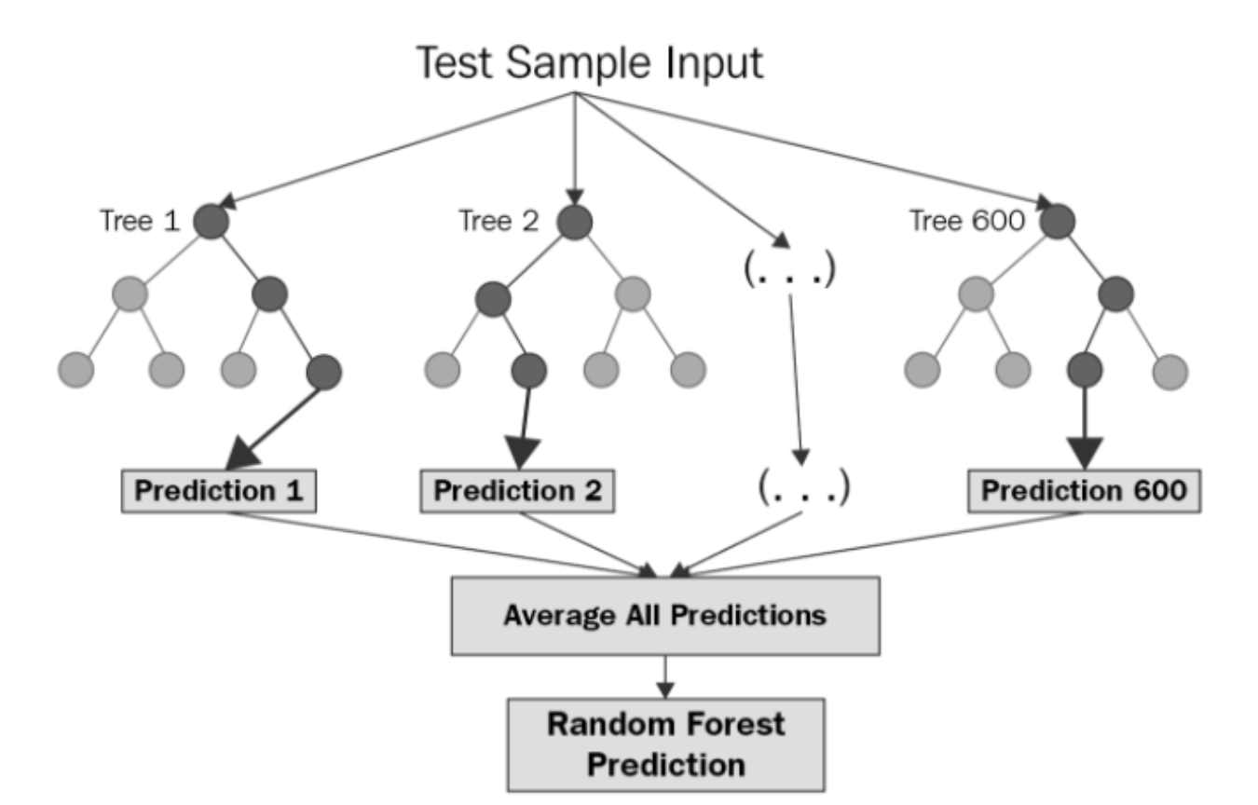
Algorithms used for Training the Model
1. Random Forest Regression
Random Forest Regression is a supervised learning algorithm that uses ensemble learning methods for regression. Ensemble learning method is a technique that combines predictions from multiple machine learning algorithms to make a more accurate prediction than a single model.

Slide 12
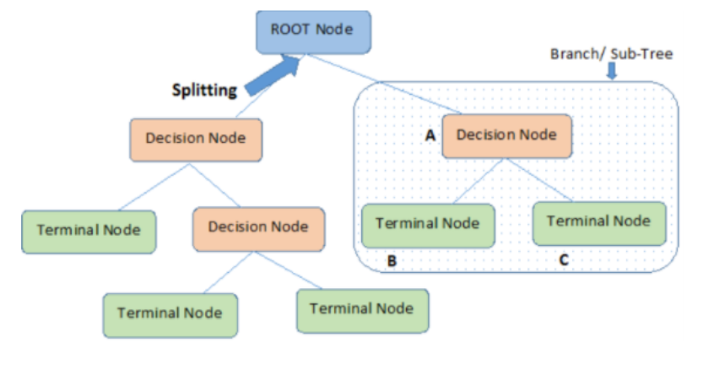
Algorithms used for Training the Model
2. Decision Tree Regression
A Decision Tree is a predictive model that uses a set of binary rules in order to calculate the dependent variable. Each tree consists of branches, nodes, and leaves.

Slide 13
Algorithms used for Training the Model
Random Forest Regression | Decision Tree Regression
Complex to Implement | Easy to Implement
Takes more space and training time Model Training time: 59.09s | Takes less space and training time Model Training time: 0.84s
Accuracy on our dataset: 99.983% Loss (RMSE): 1.14 | Accuracy on our dataset: 99.978% Loss (RMSE): 1.31

Slide 14
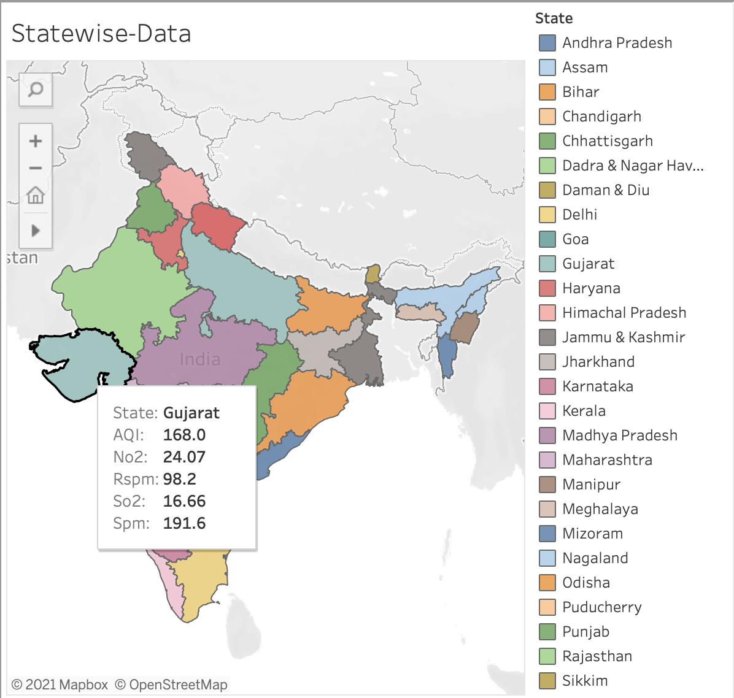
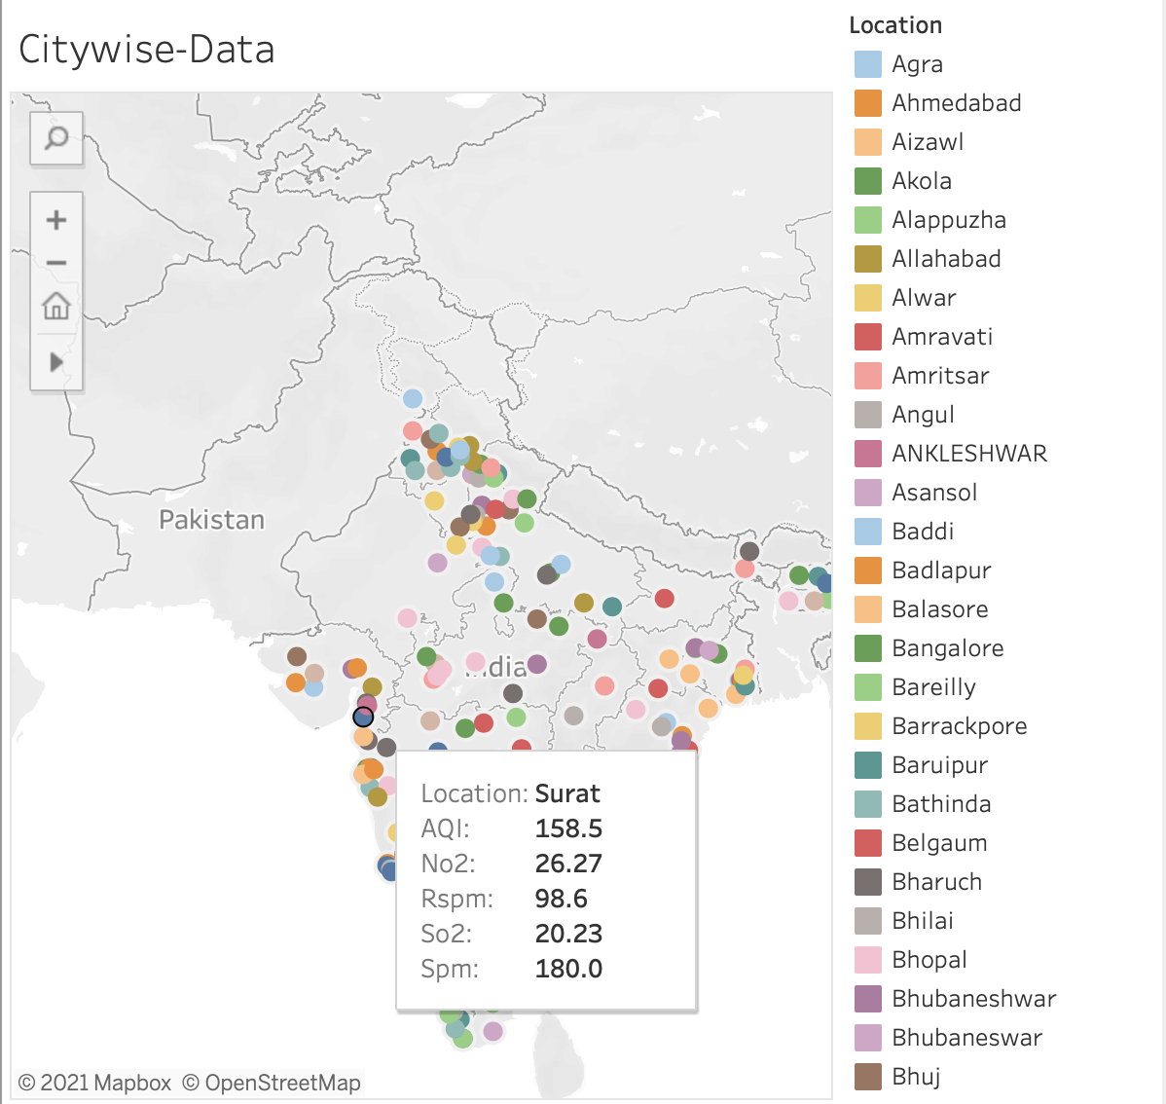
Data Visualization

Slide 15
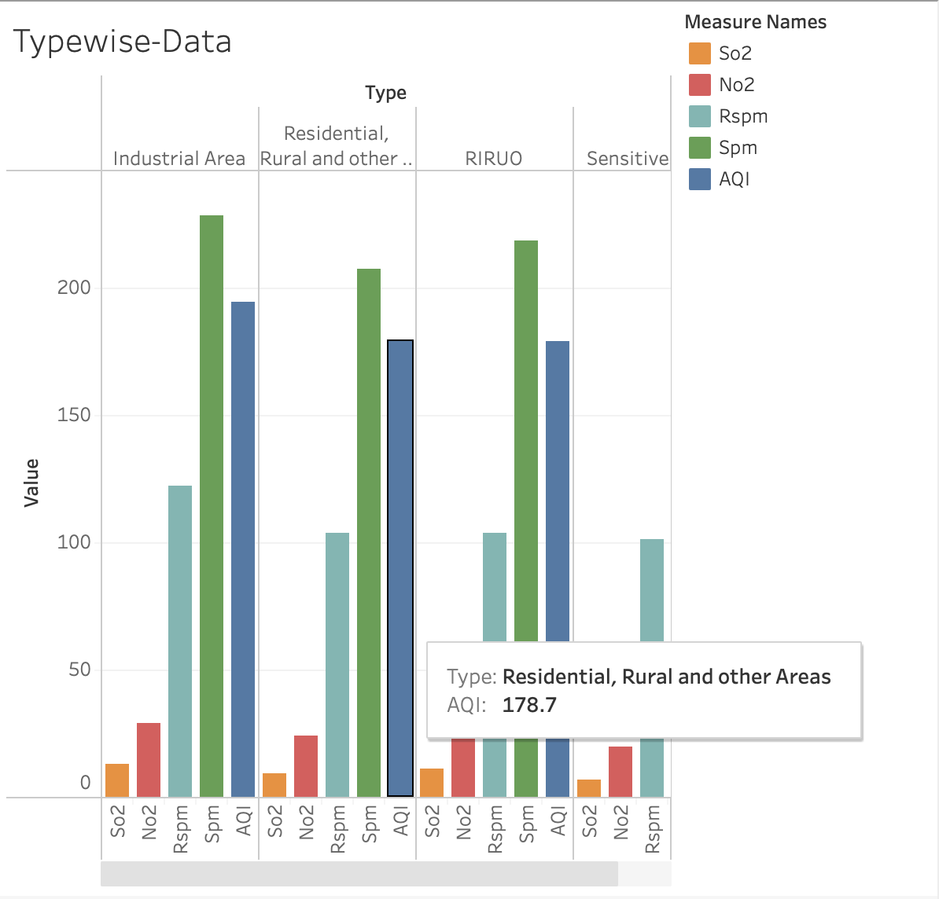
Data Visualization

Slide 16
Web-App
Created Web-Application using Flask Framework.
Why choose Flask?
Flask is a popular, open-source, and feature-rich micro web framework to make all kinds of web applications.
Features of Flask:
Extensible framework
Fast debugging
Support for cookies
Lightweight & modular
Highly flexible
Easy-to-deploy
Open-source, hence free

Slide 17
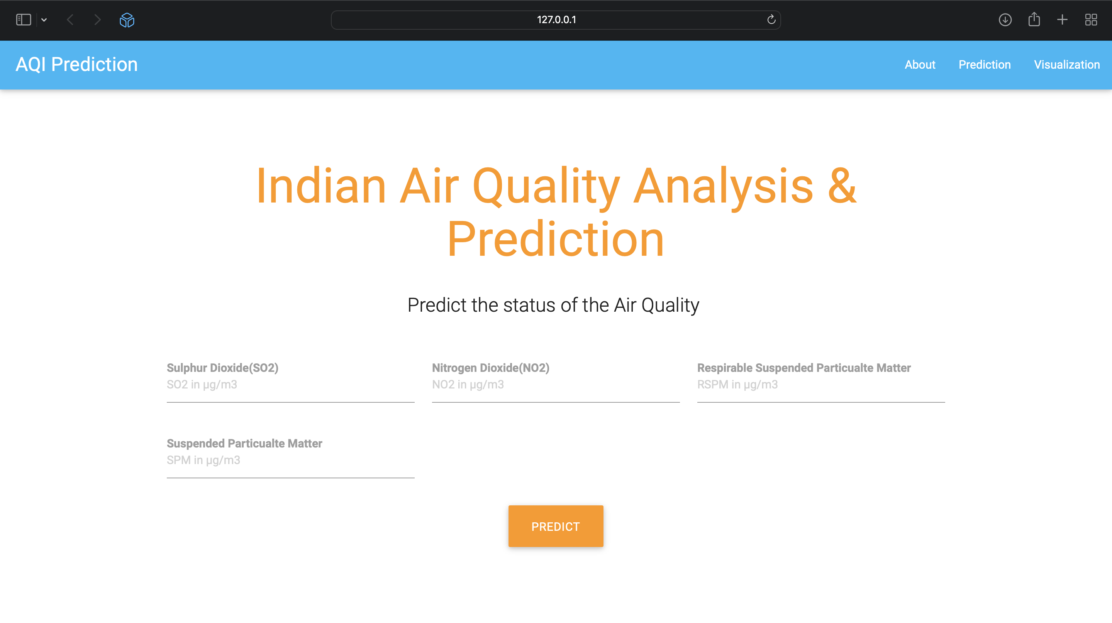
Design of Web-App

Slide 18
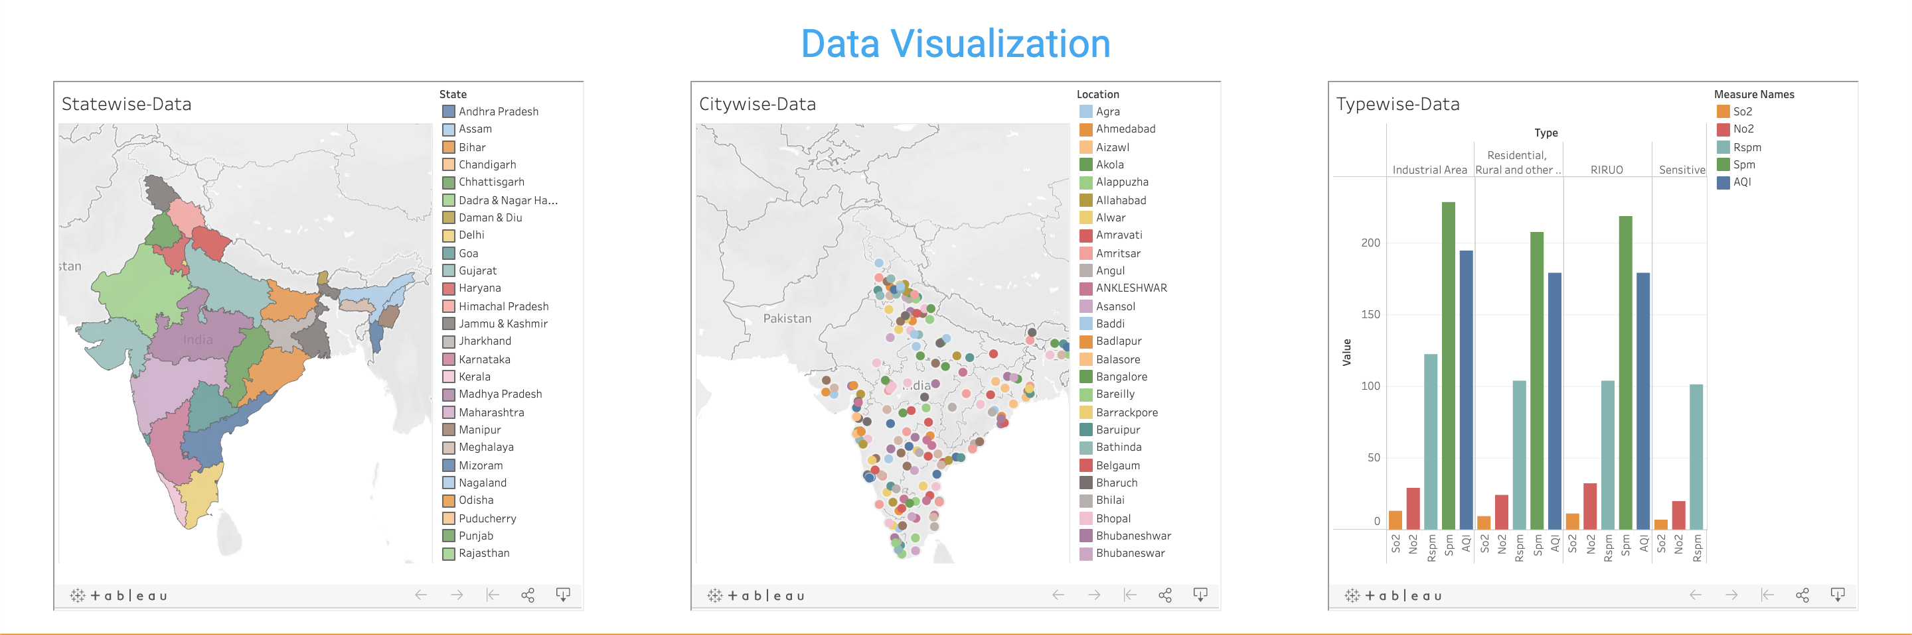
Design of Web-App

Slide 19
Future Works
New updates and studies
Give policy suggestions
Provide E-Commerce platform
Fund raising help
Industry specific guidance

Slide 20
References
M. Soundari, J. Jeslin and Akshaya, “INDIAN AIR QUALITY PREDICTION AND ANALYSIS USING MACHINE LEARNING.” (2019).
Li, Sheng-Tun & Shue, Li-Yen. (2004). Data mining to aid policy making in air pollution management. Expert Systems with Applications. 27. 331-340.
T. Madan, S. Sagar and D. Virmani, "Air Quality Prediction using Machine Learning Algorithms –A Review," 2020 2nd International Conference on Advances in Computing, Communication Control and Networking (ICACCCN), 2020, pp. 140-145.
Nasir, Humaib & Goyal, Kirti & Prabhakar, Dolonchapa. (2016). Review of Air Quality Monitoring: Case Study of India. Indian Journal of Science and Technology.
Kaur, Gaganjot & Gao, Jerry & Chiao, Sen & Lu, Shengqiang & Xie, Gang. (2018). Air Quality Prediction: Big Data and Machine Learning Approaches. International Journal of Environmental Science and Development.

